Slide 1

Flyprice predictor
Team Members
Aishwarya Jayant Rauthan
Jaishankar Govindaraj
Jasmine Gohil
Mahika Bhartari

Slide 2
our DATA$ET
DATA SOURCE : Easemytrip
Price | Price of the ticket & target variable
Airline | Names of airlines: Air India, Air Asia, Spicejet, Vistara,Indigo, GO First
From | Departure Cities (Bangalore, Delhi, Mumbai, Kolkata, Chennai)
Stop | No. of stops between source and destination cities.
To | Destination city of the flight
Class | Information on seat class (Business & Economy)
Day | The day of the month on which the flight operated
Departure Hour | The hour of the day on which the flight departed (24hr format)
Arrival Hour | The hour of the day on which the flight arrived (24hr format)

Slide 3
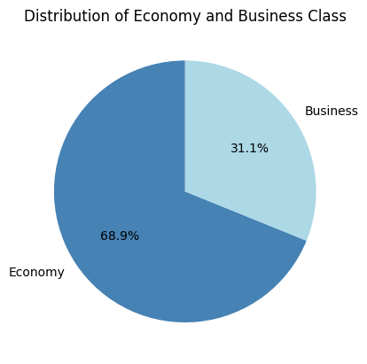
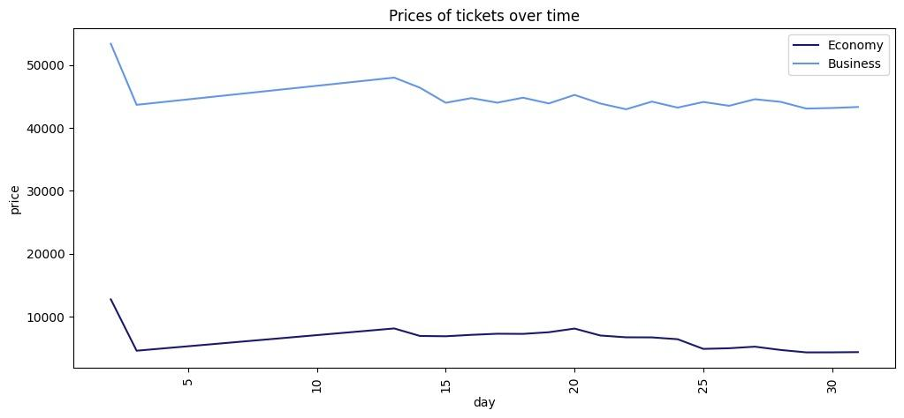
Exploring our DATA$ET

Slide 4
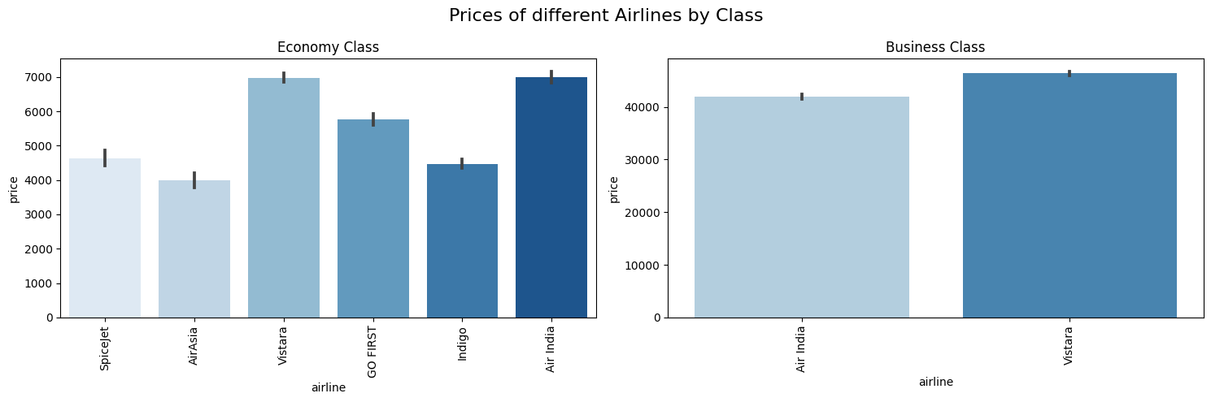
Exploring our DATA$ET

Slide 5
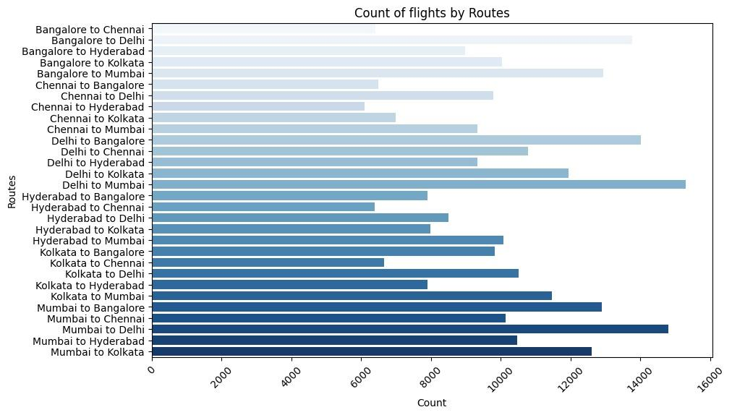
Exploring our DATA$ET

Slide 6
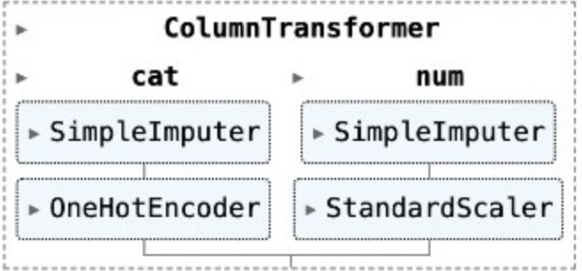
Pre-proce$$ing pipeline
Train-Test Split
80-20

Slide 7
MODEL$ WE WORKED ON
R-squared
TUNED R-squared
01
LINEAR REGRESSION
0.903
0.976
02
RANDOM FOREST
0.969
RANDOMIZED SEARCH
03
XGBOOST
0.970
RANDOMIZED SEARCH
0.975
04
K-nn regressor
0.943

Slide 8
en$emble method$
R-Squared
01
Voting
Multiple models make predictions on an average of individual model’s output
0.968
0.973
02
Stacking
Multiple models work together—base models make predictions, and a meta-model combines these predictions for improved performance

Slide 9
$electing our model
We chose to proceed with XGBoost from our two leading models, Random Forest and XGBoost Regressor.
Hyper Parameter Tuning on The Fly Price Predictor
ACCURACY
COMPUTATION TIME
RANDOM FOREST | XGBOOST
0.969 -> 0.976 | 0.970 -> 0.975
10 MIN | 3 MIN
learning_rate: 0.2
colsample_bytree: 1.0
subsample: 0.9
max_depth: 9
n_estimators: 64

Slide 10



CONCLU$ION / BU$INESS IMPLICATION
Dynamic Pricing
Optimized Cost Structure
Competitive Edge

Slide 11
Challenge$
- Optimized Parameters for computational purpose
- Conversion of datetime variables to numerical features
- Disregarded SVM model despite a positive R-Squared after tuning

Slide 12
THANK$ for flying with u$!
NOTEBOOK:
BA810-A09-FlyPrice_Predictor

